Slide 1
A Century of Serving Our Community as a Parish Hall
Welcome

Slide 2
Origins
Glebe Terriers related to East Worlington Rectory
1605 and 1613 refers to land only
1679, ‘Dairy with a chamber over it, malt house with a chamber over it, a drift (?) for drying of malt, a barn built with mud walls, a shiping (shippon) and stable.’
1727 ‘The outhouses are a barn consisting of five bays, a sheeping (shippon) of three bays and a stable of two bays all having mud walls and thatch covering…’

Slide 3
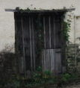
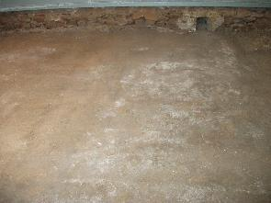
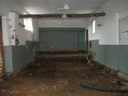
Origin
Tythe Barn or Threshing Barn or Combination
Large double doors opposite each other
The barn is divided into bays by the trusses which support the roof
Threshing Floor on one side of main doors
Floors were constructed simply of compacted earth. Rammed chalk / lime floors occur in some areas
Higher level for storage on other side of main doors

Slide 4
HLF Project Themes Serving Our Community
Community social well-being
Community cohesion and inclusivity
Community infrastructure e.g. meetings
Education and learning
Physical well-being
Interest Groups and Clubs
Culture and the Arts

Slide 5
Serving Our Community
East Worlington Population
Year | Male | Female | Total
1891 | 219 | 200 | 419
1901 | 184 | 145 | 329
1911 | 178 | 146 | 324
1921 | 168 | 152 | 320
1931 | 149 | 145 | 294
1951 | 152 | 151 | 303
1961 | 132 | 128 | 260
2011 | 107 | 113 | 220

Slide 6
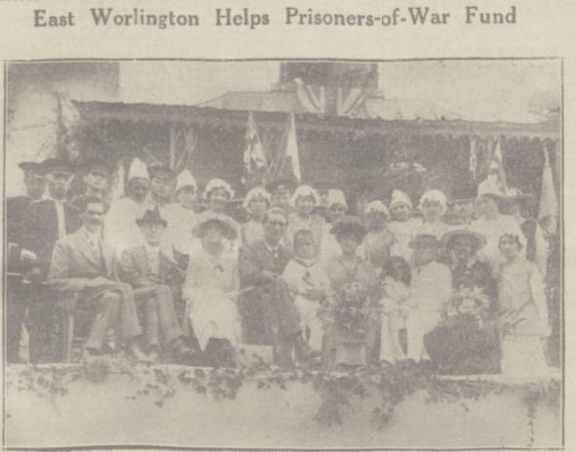
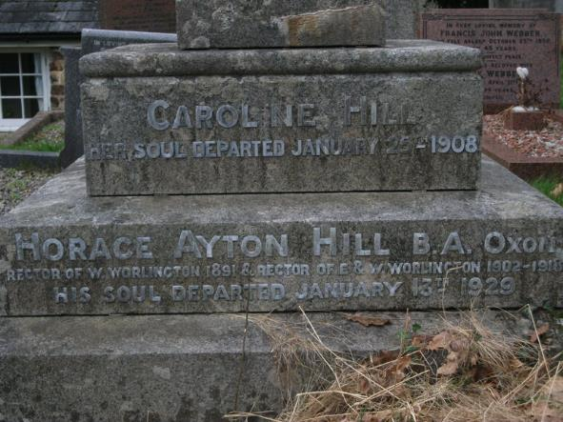
Reverend Horace Ayton Hill (B.A.) Era
Rector West Worlington 1891
Rector East Worlington 1902
Retired 1919
Died 1929
‘As a minister he was loved by all and was a keen worker amongst his parishioners. For many years he acted a secretary to the Worlington Flower Show.’

Slide 7
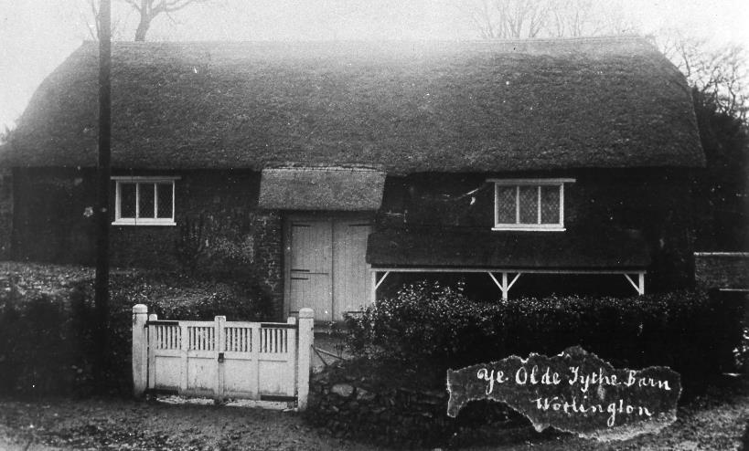
Ye Olde Tythe Barn
Rev. H.A.Hill who referred to the house in his
“East Worlington Kalendar of Quotidian Quotations” of 1910
‘The barn … has been converted by the present Rector into a Parish Room, and is known as
“Ye Olde Tythe Barn.”’

Slide 8
Dairy School at East Worlington 1909

Slide 9
Inside View of Hall

Slide 10
Parochial Dance on Shrove Tuesday 1906
Music by Mr F Lovell (Chulmleigh)
and during interval
Gramophone Mr Mounts (Afton)

Slide 11
Reverend Henry John Hodgson (M.A.) Era
Rector from 1919 to 1937
Before Worlington:
birth was on 20th March 1860 in Brighton, Sussex
Headmaster St Peter’s School, Exmouth 1890 to 1913
Ordination Service held in Exeter Cathedral on 10th June 1906
Hodgson was licensed as curate at Withycombe Raleigh in Exmouth.
24th October 1913 Henry John Hodgson was licenced by the Bishop of Exeter to be curate of Crediton

Slide 12
Reverend Henry John Hodgson - Tragic Mistake
Reverend Hodgson
Used a Boer artillery shell as a door-weight in his sitting room, never supposing it was ‘alive’.
He also possessed a sword bayonet for French Manufacture.
On 24th December 1913 he intended to bend the bayonet and attach it as a crook to the shell.
He heated and bent the bayonet, took out the percussion cap, and inserted the end of the hot bayonet in the hole in the shell.
The shell immediately exploded with serious effects.
Hodgson’s right leg was fractured below the knee his right wrist terribly lacerated, and his face badly burned by the igniting powder.
This rendered Reverend Hodgson disabled for the rest of his life.

Slide 13
WW1 National Memorial Initiative
Following World War 1 those who served and died should be remembered.
National level: a national memorial in London which Government would pay for.
Local level: The Government would not pay for local war memorials and that these should be the responsibility of local communities.

Slide 14
WW1 Local Memorial Initiative
Meeting in East Worlington supported provision of a Memorial Hall.
The view that it must be the absolute property of the parish, and in which all kinds of entertainment and meetings could be held.
The Rector explained that in all probability the Old Tithe Barn would be put up for auction in the near future or failing a purchaser would be demolished.
It rested with the Committee to decide whether or not they shall purchase the old building and renovate it.
There is no doubt that the expenditure of, say, £100 or £150 would provide a very fine room as a Memorial Hall, at a fraction of the cost of erecting an entirely new building.
Amid much enthusiasm Mr Stucley announced that he would start the ball rolling with a donation of £50.

Slide 15
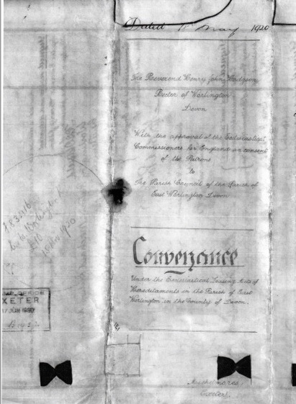
Sale of the Barn
Conveyance 18th May 1920
£10

Slide 16
Use of Hall During 1920s and 1930s
Whist Drives | Rifles Club
Dances | Bazzars and Sales
Choir Suppers | Election Addresses
Ringers Suppers | Dairy School
Lady Stucley Children’s Treat | Sunday School Treats
Concerts | Meetings
Sports Club Events | Farmers Club

Slide 17
The War Years
The Hall continued to serve the community
Parish continued to have own rectors
Reverend T.H.E. Woods (1937 to 1942)
Reverend W.H. Maddock (1937 to 1960)
Home Guard 1940 to 1943
Evacuees
Searchlight Camp

Slide 18
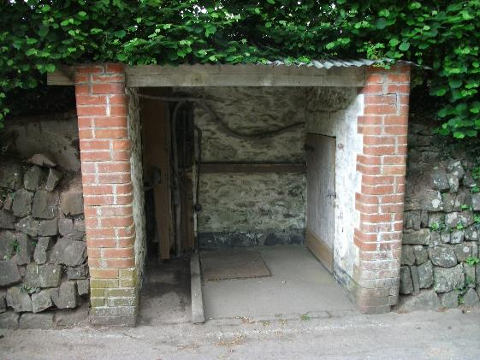
1950 Decade of Utilities and Facilities
Electric
Heating
Water
Kitchen Developments? (Expenditure British Railways 21st October 1958)

Slide 19
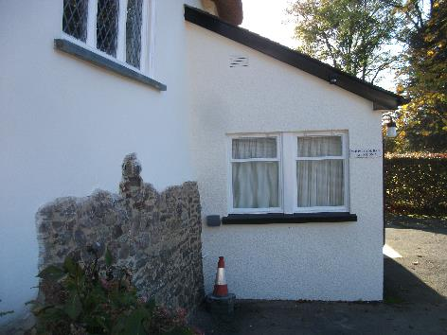
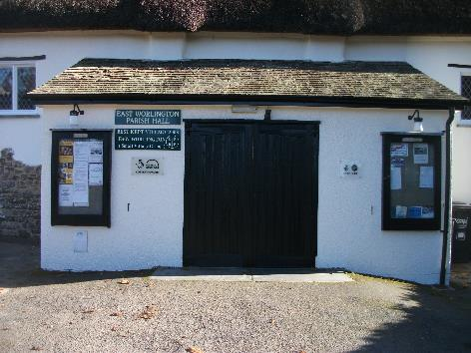
1960’s
Important relationship between owners of East Worlington House and East Worlington Parish Hall
Impact of the Stevens owners of East Worlington House
Toilets and Foyer
Storeroom

Slide 20
1970 Start of Sponsored Walk

Slide 21
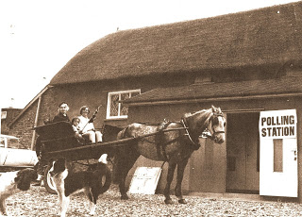
1970s
Charity Status 28th August 1974
Listed Building Registration 03rd October 1975
EEC Referendum 1975

Slide 22
1993 A Good Old Fashioned Music Hall

Slide 23
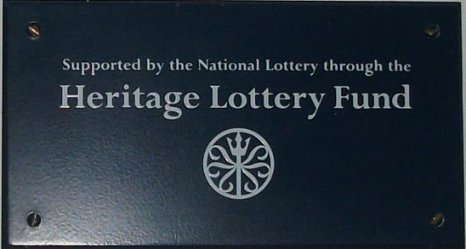
1990s / 2000 Securing the Future
Constitution
Lease
Holding Trustees – Charity Commission
Conservation of Hall
Millennium Project - in 2000 the Hall was restored using traditional materials

Slide 24
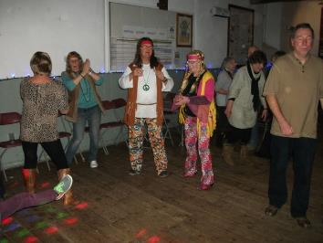
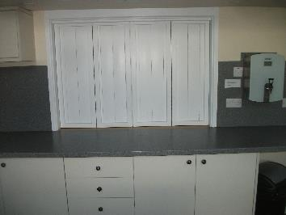
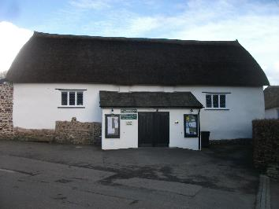
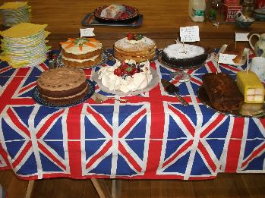
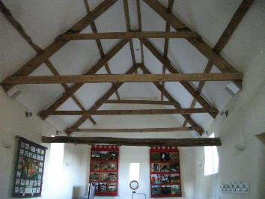
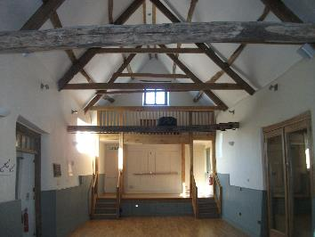
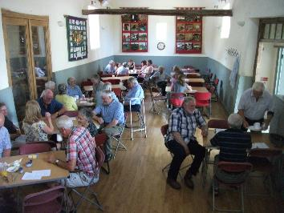
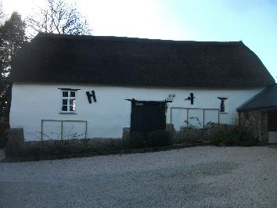
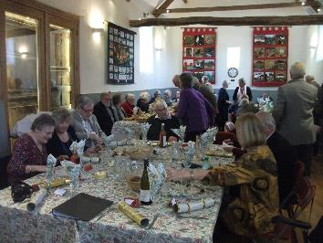
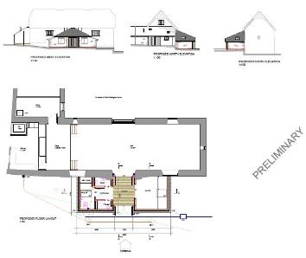
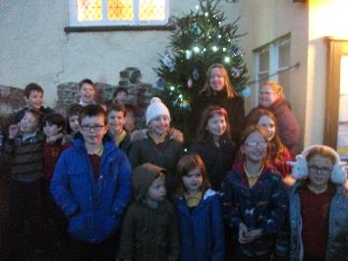
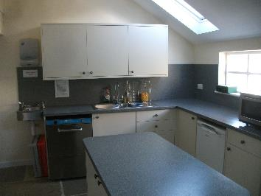
Features of 2010s
Conservation and Improvements
Main Hall
Kitchen
Foyer
Fund-raising
Community Programme
Brunch
Laughing Cockerel
Events
Lunches
Talks
Entertainment
Quizzes

Slide 25
The Future Another Century Serving Our Community Driving Principles
Conservation
Community
Celebration

